Slide 1
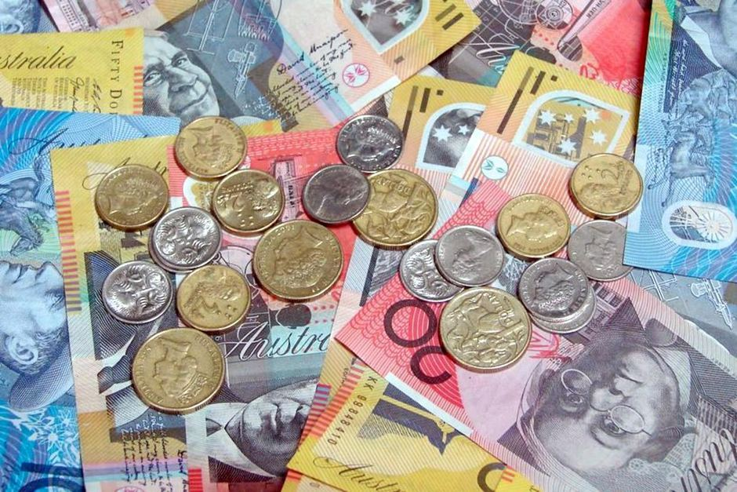

My Money
Interactive Notebook
Ms. Latham
1

Slide 2
Contents
Glossary or Formula Page
Page
Date
Description
2
3

Slide 3
Tasks
24
7
30
Essential Question
Questions
Notes
Summary
4
5

Slide 4
24
7
30
Date
Title
EQ –

Slide 5
24
7
30
Date
Rates
EQ – What are rates and how are they used?
What are rates?
A rate is a comparison of quantities of different kinds.

Slide 6


24
7
30
Date
Rates
EQ – What are rates and how are they used?
What are rates?
A rate is a comparison of quantities of different kinds.
Some examples of rates are:
Rent – Dollars per week.
Call costs – Dollars per minute.

Slide 7
24
7
30
Date
Rates
EQ – What are rates and how are they used?
What are rates?
A rate is a comparison of quantities of different kinds.
Some examples of rates are:
Rent – Dollars per week.
Call costs – Dollars per minute.
Example: It costs you $0.40 per minute for local calls on your mobile phone.
$0.40 per minute or $0.40/minute

Slide 8

24
7
30
Date
Rates
EQ – What are rates and how are they used?
What we know →$30 for 6 Kilograms
How do I simplify rates?
What we want to know → How much money for one kilo?
How to get from 6 kg to 1 kg?
(divide by 6)
Now divide both sides by 6 = $\frac{\$30}{6}$ for $\frac{6 kg }{6}$
=$5 for 1 kilogram
=$5/kg

Slide 9
LHS - Notes
Try these questions by yourself then check with a partner
1. Simplify $18 for 9 minutes
2. Simplify $75 for 15 boxes
Extra: If 5 kg of potatoes costs $5.95 how much does 7 kg cost?

Slide 10
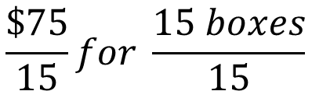
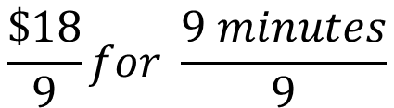

LHS - Notes
Try these questions by yourself then check with a partner
1. Simplify $18 for 9 minutes
2. Simplify $75 for 15 boxes
How do we get from 9 minutes to 1 minute?
How do we get from 15 boxes to 1 box?
$$\frac{\$18}{9}for \frac{9 minutes}{9}$$
$$\frac{\$75}{15}for \frac{15 boxes}{15}$$
Divide by 9
Divide by 15
$2 for 1 minute or $2/minute
$5 for 1 box or $5/box
Extra: If 5 kg of potatoes costs $5.95 how much does 7 kg cost?
5 kg for $5.95
Divide by 5
$$\frac{5}{5} for \frac{\$5.95}{5}$$
1 kg for $1.19
7 kg for $8.33
Multiply by 7

Slide 11

24
7
30
Date
Rates
EQ – What are rates and how are they used?
How are rates used?
A rate allows us to compare prices and can help us find the cost of a different amount

Slide 12
Conclusion
Quickwrite – 2 minutes write a summary for todays lesson
A few ideas to get started:
What was your process of solving rates?
What is the purpose of rates?
Notes:
To help structure the quickwrite if students need prompting – what was your process of solving rates??

Slide 13
Notes Review
24, 7 ,30
Date
Title
Essential question
Notes complete
Notes complete with colour and diagrams
Questions completed
Contents page filled in
Formula page filled in

Slide 14
Homework
Review your notes and write a summary answering the essential question.

